Slide 1
Heart Disease Prediction Using Machine Learning
BISHAL GHOSH
CHAYAN DATTA
NILOTPAL MAJUMDAR
SAYAN PAUL

Slide 2
INTRODUCTION
What is Machine Learning ?
Goal of the Project
What is Supervised Learning ?

Slide 3
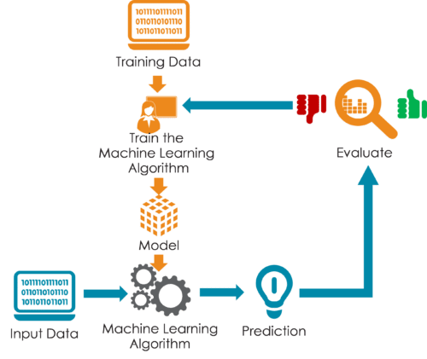

Slide 4
MACHINE LEARNING ALGORITHMS USED BY US

Slide 5

Logistic Regression

Slide 6
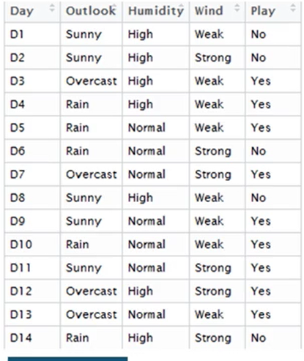
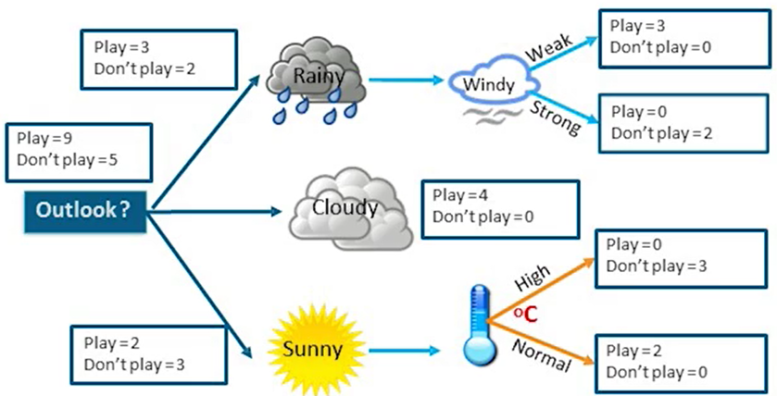
Decision Tree

Slide 7
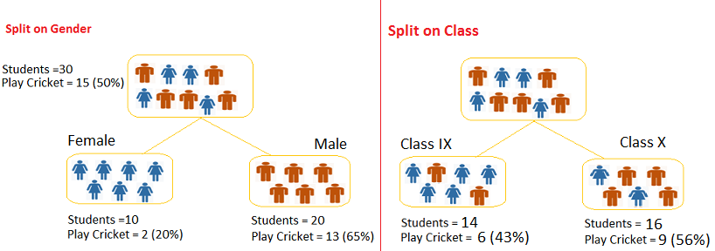
Gini for Binary Splitting
Gini for sub-node Class IX = (0.43)*(0.43)+(0.57)*(0.57)=0.51
Gini for sub-node Class X = (0.56)*(0.56)+(0.44)*(0.44)=0.51
Calculate weighted Gini for Split Class
= (14/30)*0.51+(16/30)*0.51 = 0.51
Calculate Gini for sub-nodes, using formula sum of
square of probability for success and failure (p^2+q^2).
Calculate Gini for split using weighted Gini score of each node of that split
Calculate, Gini for sub-node Female = (0.2)*(0.2)+(0.8)*(0.8)=0.68
Gini for sub-node Male = (0.65)*(0.65)+(0.35)*(0.35)=0.55
Calculate weighted Gini for Split Gender = (10/30)*0.68+(20/30)*0.55 = 0.59

Slide 8
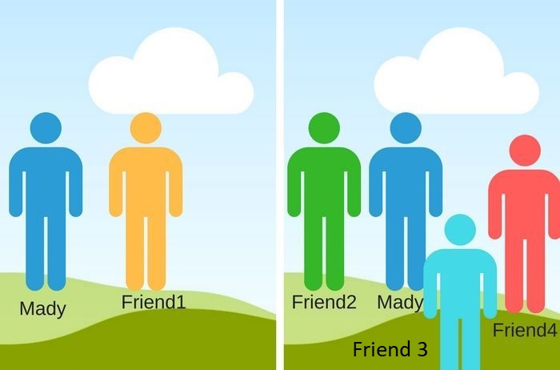
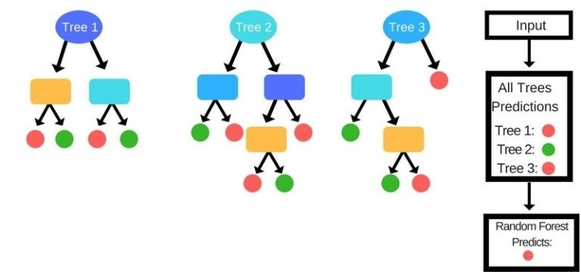
Random Forest

Slide 9
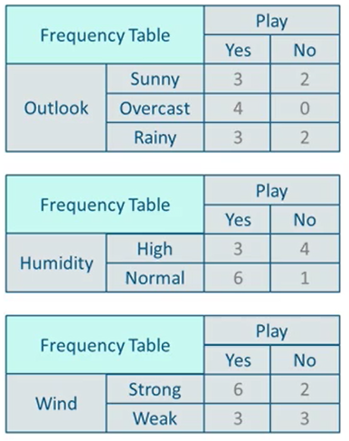
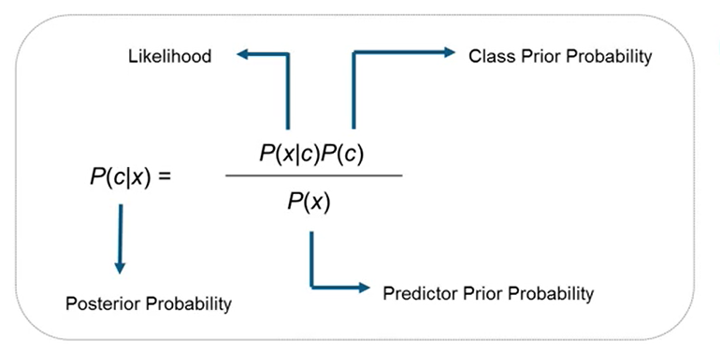
Naive Bayes

Slide 10
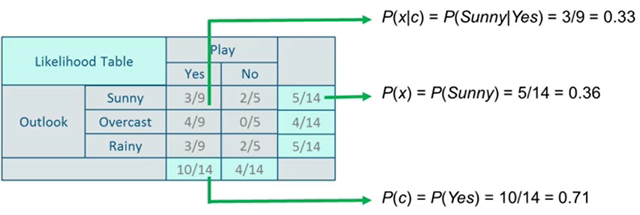
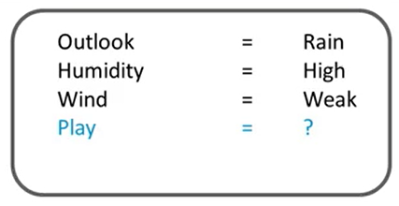
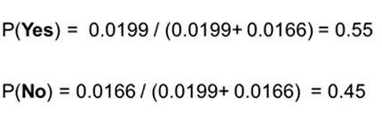
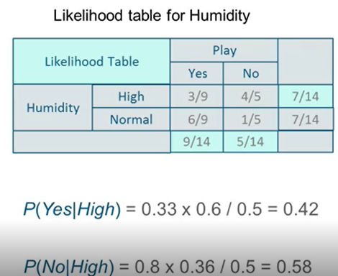
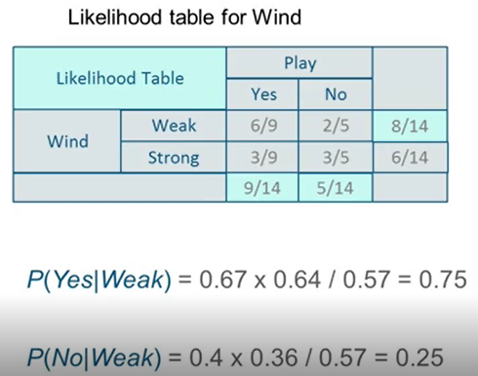
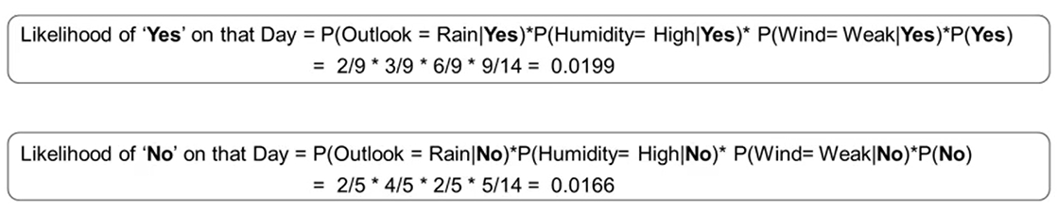

Slide 11
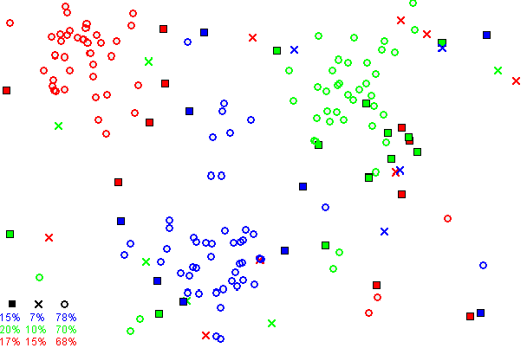
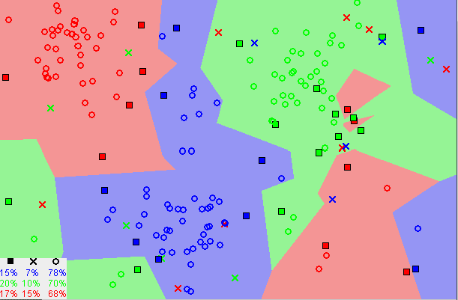
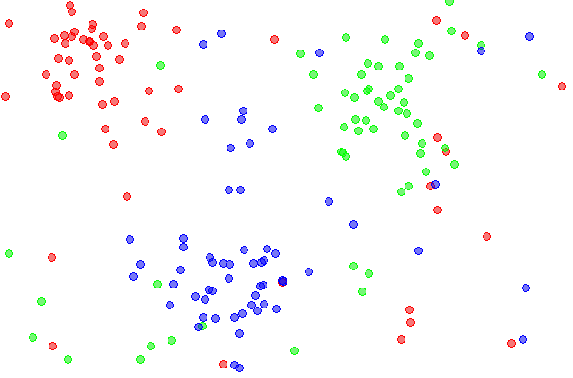
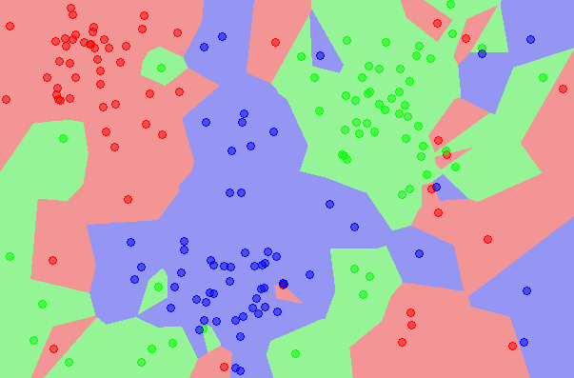
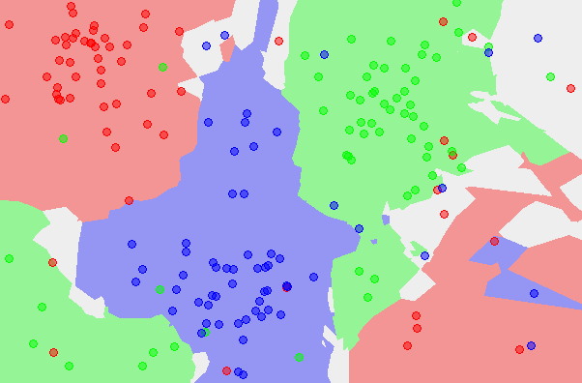
K-NN
The 5NN classification
THE 1NN CLASSIFICATION
The CNN reduced dataset.
DATASET
The 1NN classification map based on the CNN extracted prototypes

Slide 12
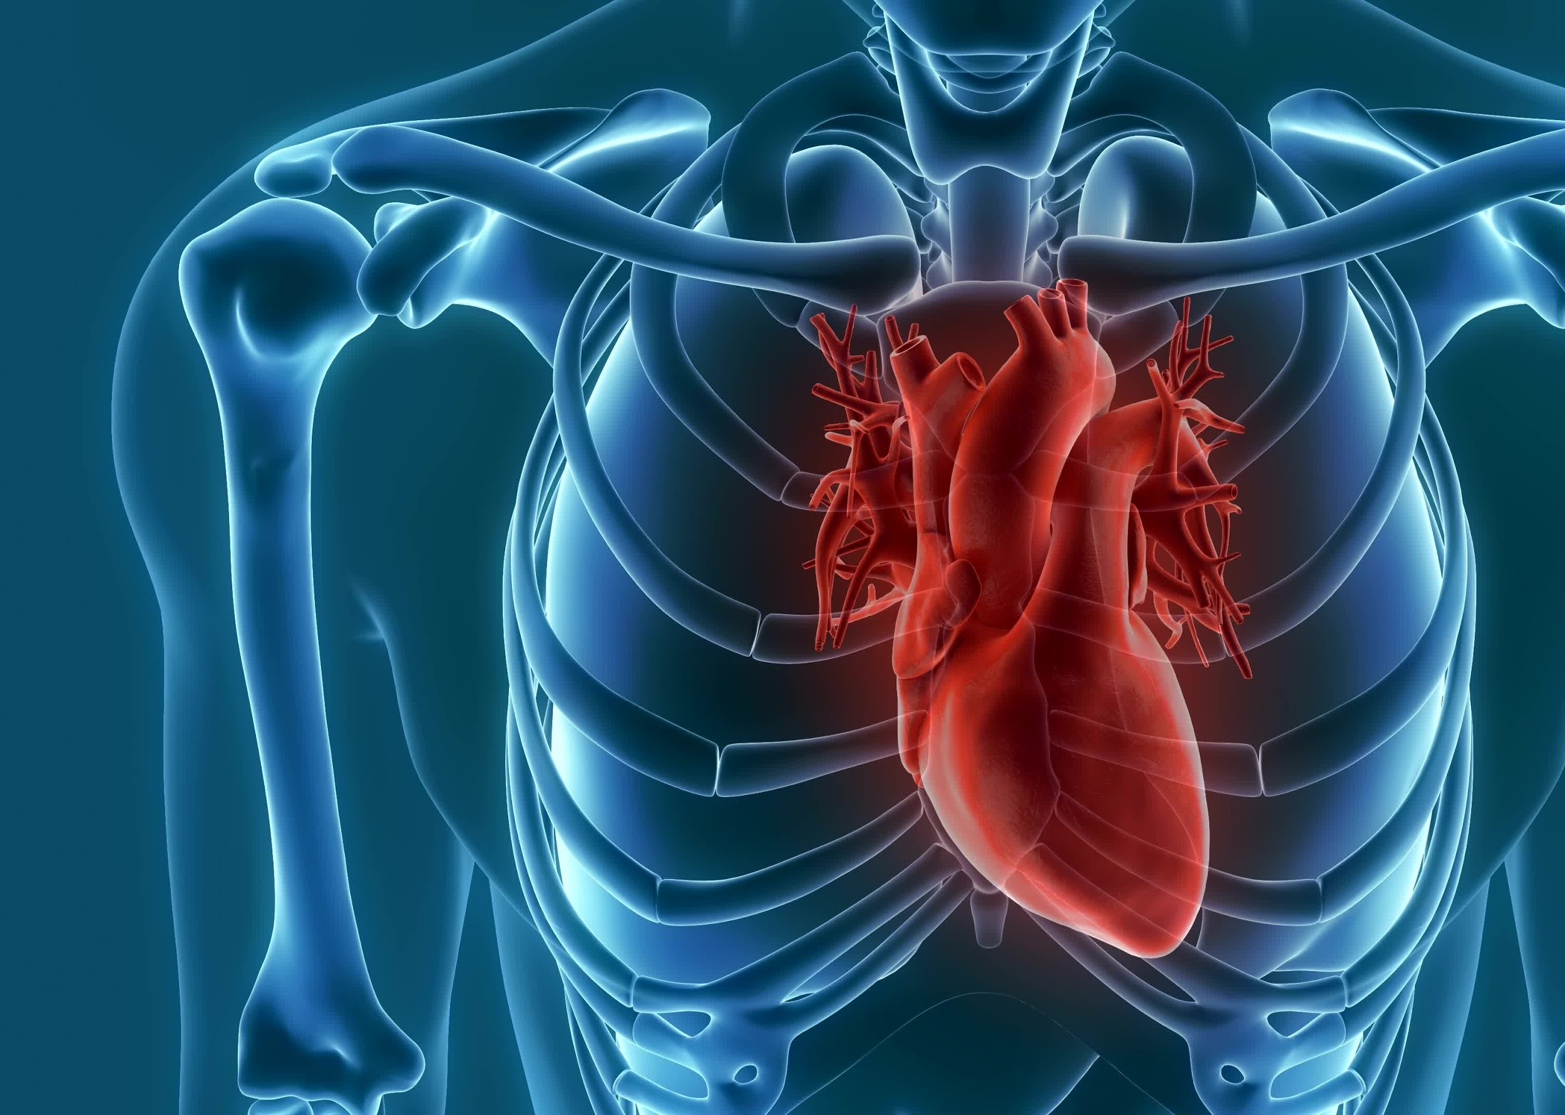
The Working of the Project

Slide 13
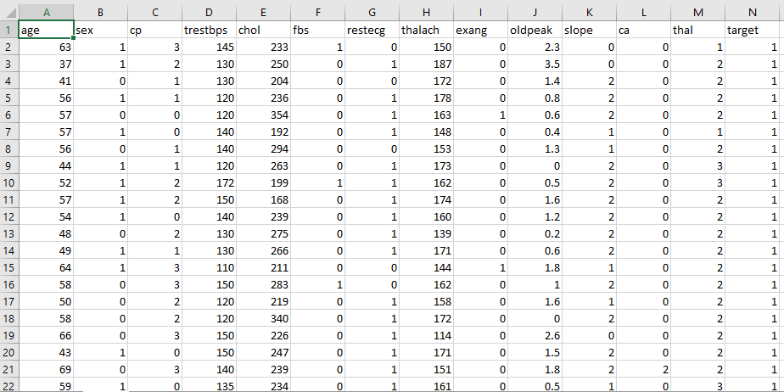
Dataset

Slide 14
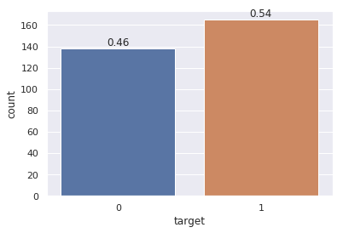
1 165
0 138

Slide 15
3 step process
Split the dataset
Train the dataset
Compare the Algos

Slide 16






Slide 17
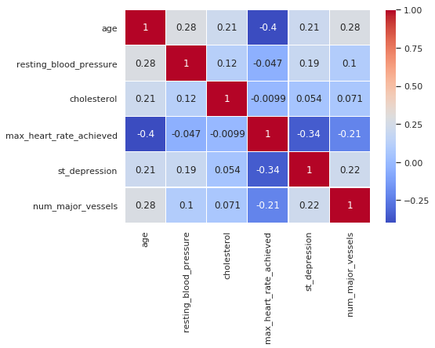
Correlation
Plot

Slide 18
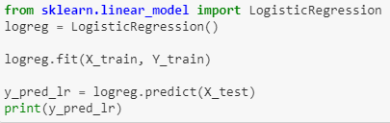
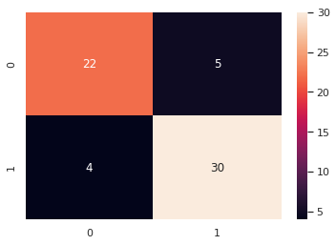
Logistic Regression
accuracy score : 85.25 %
Precision: 0.85
Recall is: 0.88
F-Score: 0.86

Slide 19
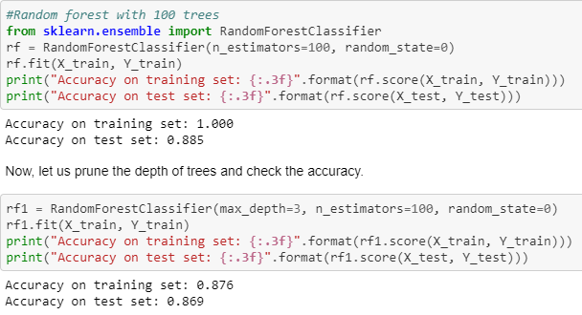
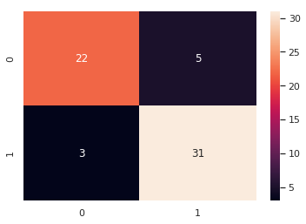
Random Forest
Precision: 0.86
Recall is: 0.91
F-Score: 0.88

Slide 20
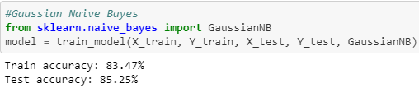

Naive Bayes
Precision: 0.83
Recall is: 0.91
F-Score: 0.87

Slide 21
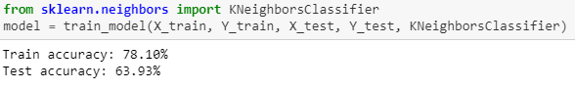
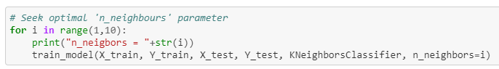
K-Nearest Neighbor

Slide 22
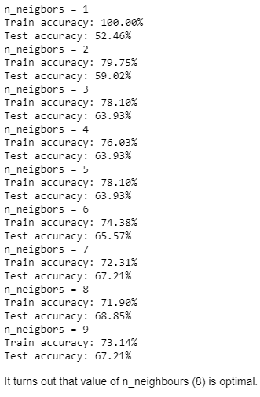
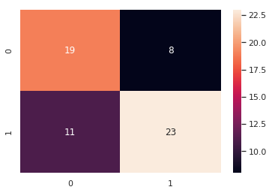
Precision: 0.74
Recall is: 0.67
F-Score: 0.70

Slide 23
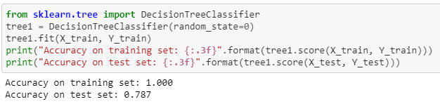
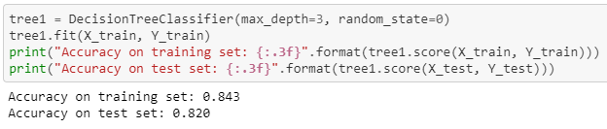
Decision Tree

Slide 24
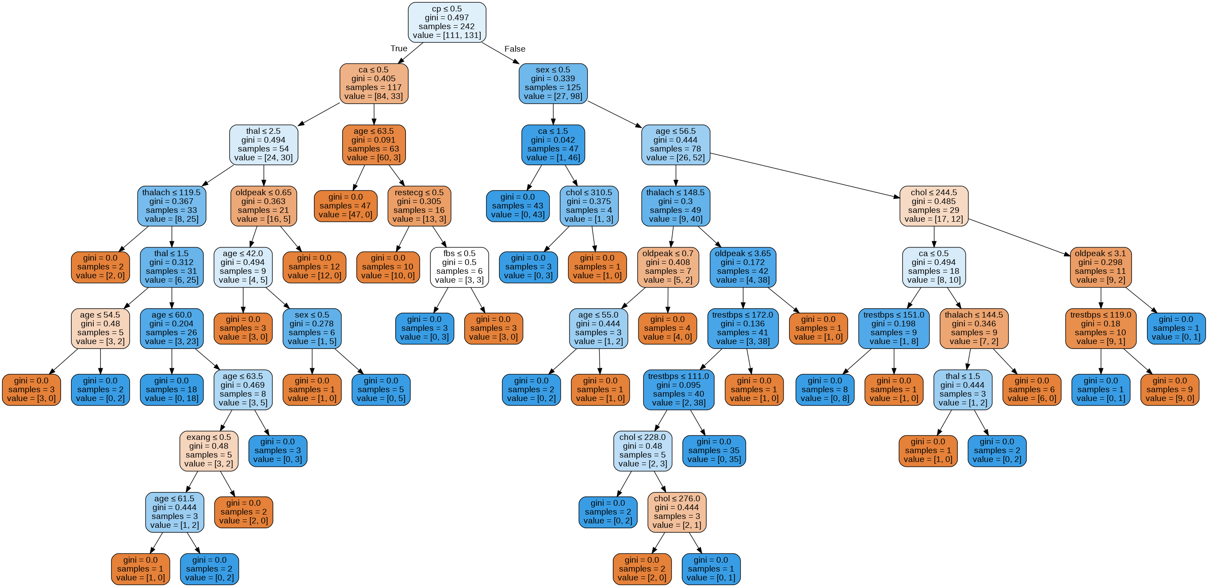
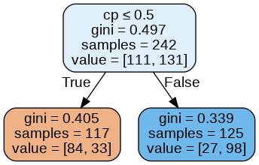

Slide 25
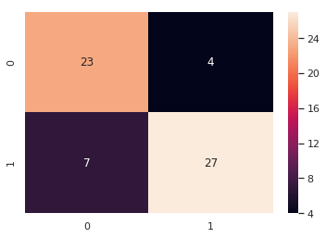
Precision: 0.87
Recall is: 0.79
F-Score: 0.83

Slide 26
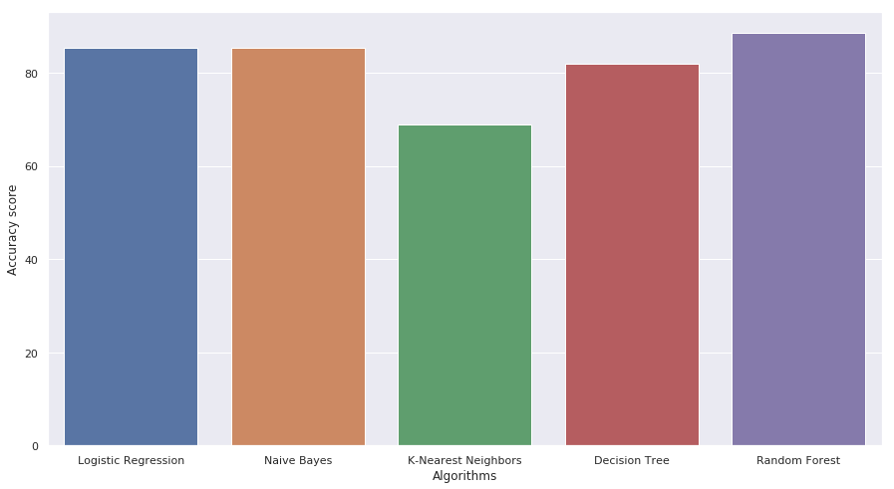
Results
85.24%
68%
81.9%
88.52%
85.24%

Slide 27
Conclusion
Drawbacks
Future Scopes

Slide 28


